Slide 1
important Reference sites
National Geographic Area Coordination Centers, Fire Code, and Wildland Fire Decision Support System (WFDSS)

Slide 2
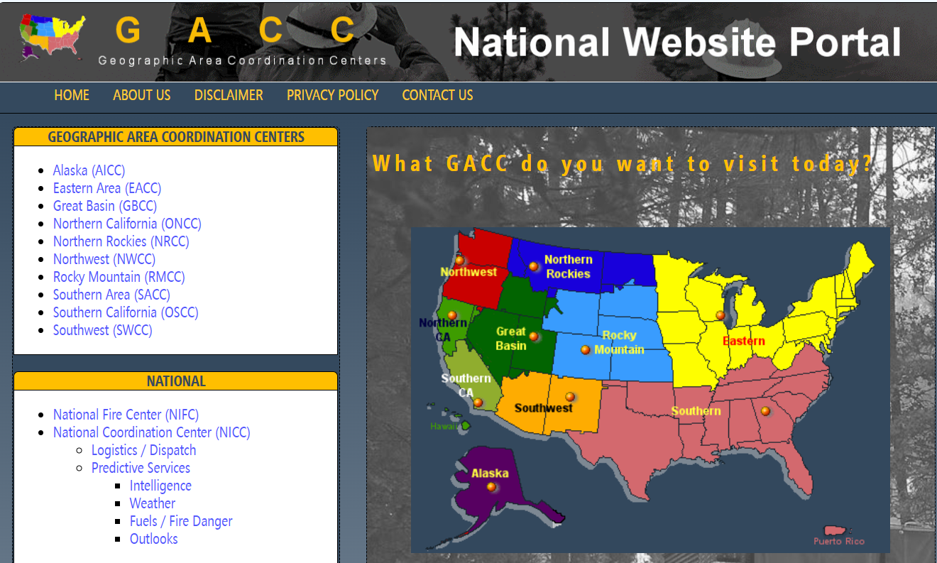
National Geographic Area Coordination Centers
This link will direct you to the different geographic areas to collect geographic information like business practices, point of contacts, etc. National Geographic Area Coordination Centers Link

Slide 3
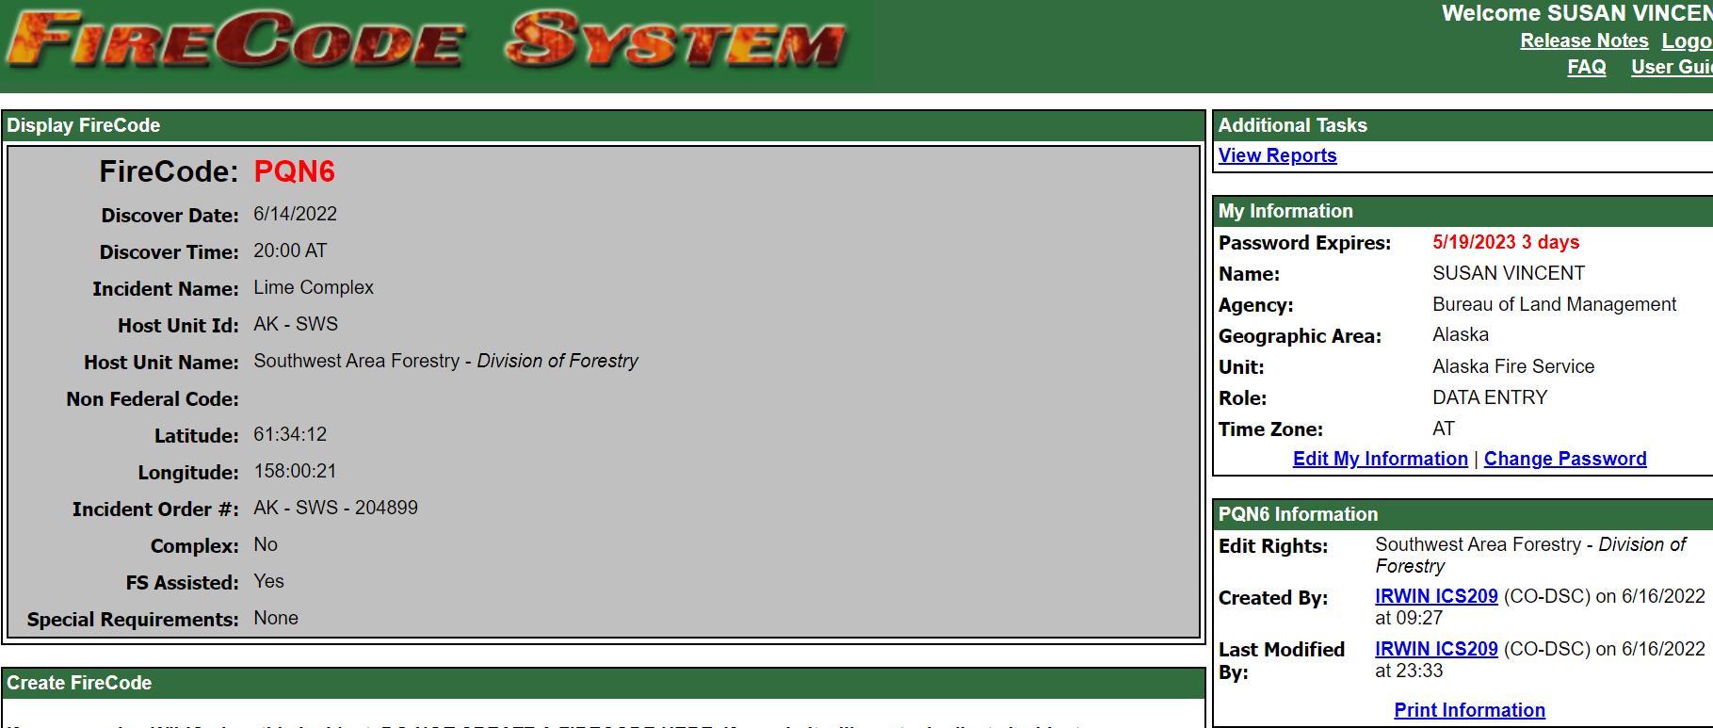
Fire Code Fire Code Link
Fire Code allows you to look up fire numbers to ensure accuracy or give you a POC/owner of fire number.

Slide 4
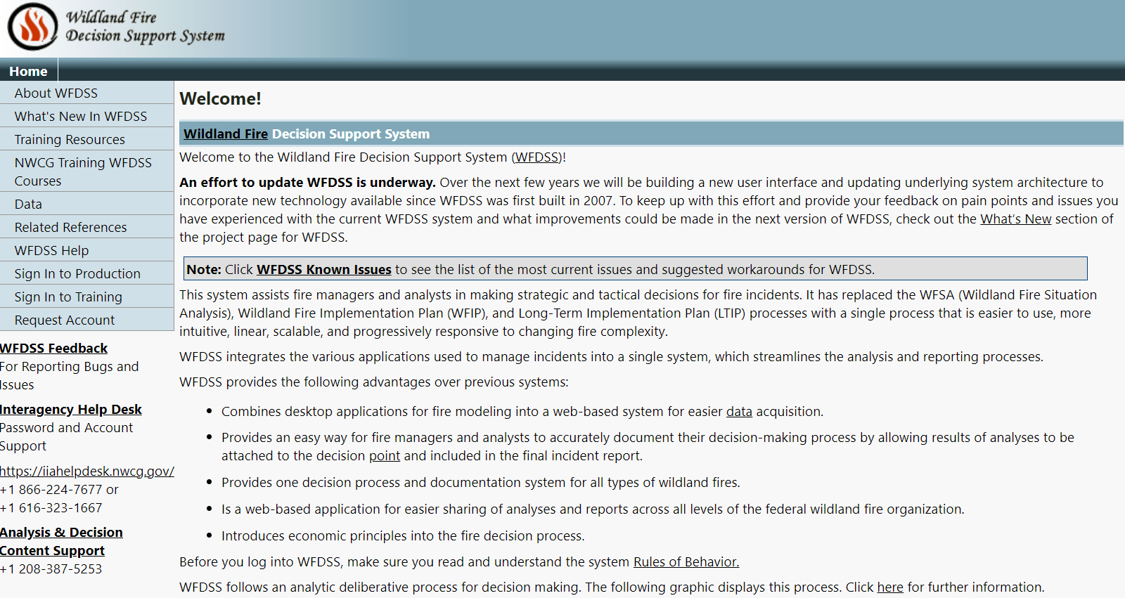
Wildland Fire Decision Support System (WFDSS) WFDSS Link
WFDSS allows you track the process of the decision or pull the finalized decision.

